Slide 1

Generation of Explicable Plans for
Robot Task Planning
Anagha Kulkarni*, Sarath Sreedharan, Tathagata Chakraborti, Yu Zhang, Subbarao Kambhampati Department of Computer Science Arizona State University
Plan = { a_{1,} a_{2,} a₃, …, a_{n} }
task₁
task₂
goal

Slide 2
Explicability among Humans
We, as humans, while interacting make an effort to be understood.
Agents behave explicably if their actions/views are clearly understood by other agents.
Explicability is crucial for good team performance.
Notes:
Explicability comes to us naturally.
For example, in a team, each agent has an expectation about the other agent.
When team members are collaborating on a plan, each member is expected to behave in an explicable fashion.
Example:

Slide 3
Explicability
For the reasons, explicability is important for human-human teams, so it is for human-robot teams.
Explicability
Human’s expectation
of agent behavior
Hidden in human’s mind
Notes:
In such cases, interaction can become difficult and result into inexplicability.
Inexplicability can result in cognitive load for the agents and reduce the overall team performance. In the worst case, it can cause safety concerns and result in accidents.
Here it becomes crucial for an agent to understand other agent’s interpretation of itself and behave as per the interpretation.

Slide 4

Explicability
For the reasons, explicability is important for human-human teams, so too it is important for human-robot teams.
Explicability
Human’s expectation
of agent behavior
Hidden in human’s mind
Goal: Clear a cluttered table
Move to the table
Move to the table
Keep books on shelf
Push the items
off the table
Keep the
coffee mug
Keep pen in
pen holder
Table is clear
Notes:
In such cases, interaction can become difficult and result into inexplicability.
Inexplicability can result in cognitive load for the agents and reduce the overall team performance. In the worst case, it can cause safety concerns and result in accidents.
Here it becomes crucial for an agent to understand other agent’s interpretation of itself and behave as per the interpretation.

Slide 5
Explicability
For the reasons, explicability is important for human-human teams, so too it is important for human-robot teams.
Explicability
Human’s expectation
of agent behavior
Hidden in human’s mind
Goal: Clear a cluttered table
Crucial for an agent to understand other agent’s interpretation of itself.
Move to the table
Move to the table
Keep books on shelf
expectations
are not met
Confusion and surprise
Cognitive load
Safety concerns
Push the items
off the table
Keep the
coffee mug
Inexplicability
Keep pen in
pen holder
Table is clear
Notes:
In such cases, interaction can become difficult and result into inexplicability.
Inexplicability can result in cognitive load for the agents and reduce the overall team performance. In the worst case, it can cause safety concerns and result in accidents.
Here it becomes crucial for an agent to understand other agent’s interpretation of itself and behave as per the interpretation.

Slide 6
Plan Explicability for Autonomous Robots
Autonomously
construct task plans
Notes:
We need a way to measure the explicability of the plan.
Although the challenge here is, … we will see the coming slides how this problem is tackled.

Slide 7
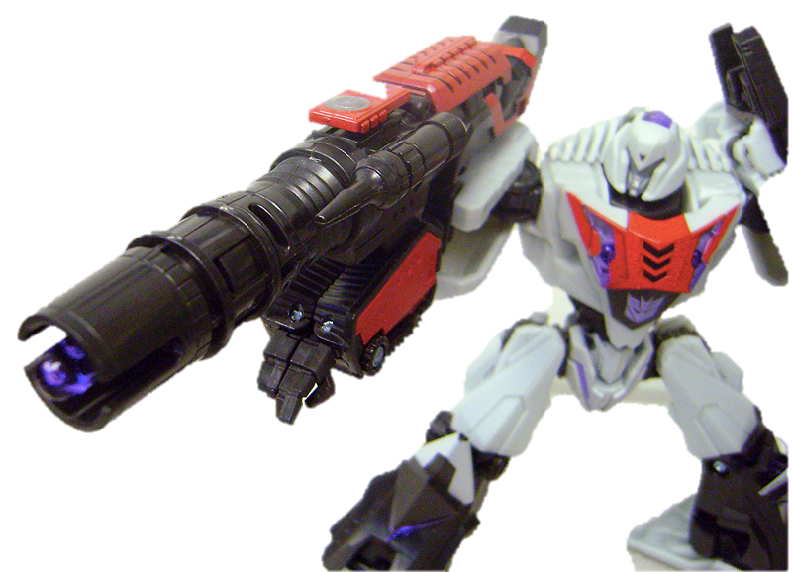
Plan Explicability for Autonomous Robots
Can be incomprehensible
& result in safety concerns
Optimal Plan
Autonomously
construct task plans
Candidate plans
Notes:
We need a way to measure the explicability of the plan.
Although the challenge here is, … we will see the coming slides how this problem is tackled.

Slide 8
Plan Explicability for Autonomous Robots
Filtered by plan
explicability measure
Optimal Plan
Autonomously
construct task plans
Candidate plans
Explicable Plan
Notes:
We need a way to measure the explicability of the plan.
Although the challenge here is, … we will see the coming slides how this problem is tackled.

Slide 9
Contribution
Introduced the explicability measure for task planning
Incorporated this measure as a heuristic in our search process
Investigated two general scenarios for planning with explicability
Human as a passive observer
Human-robot peer-to-peer teams
Evaluated task scenarios using physical robot experiments

Slide 10
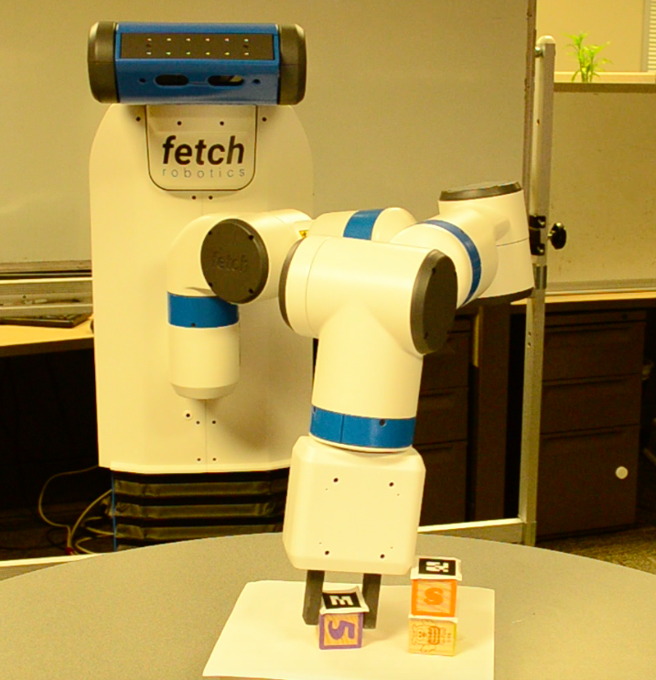
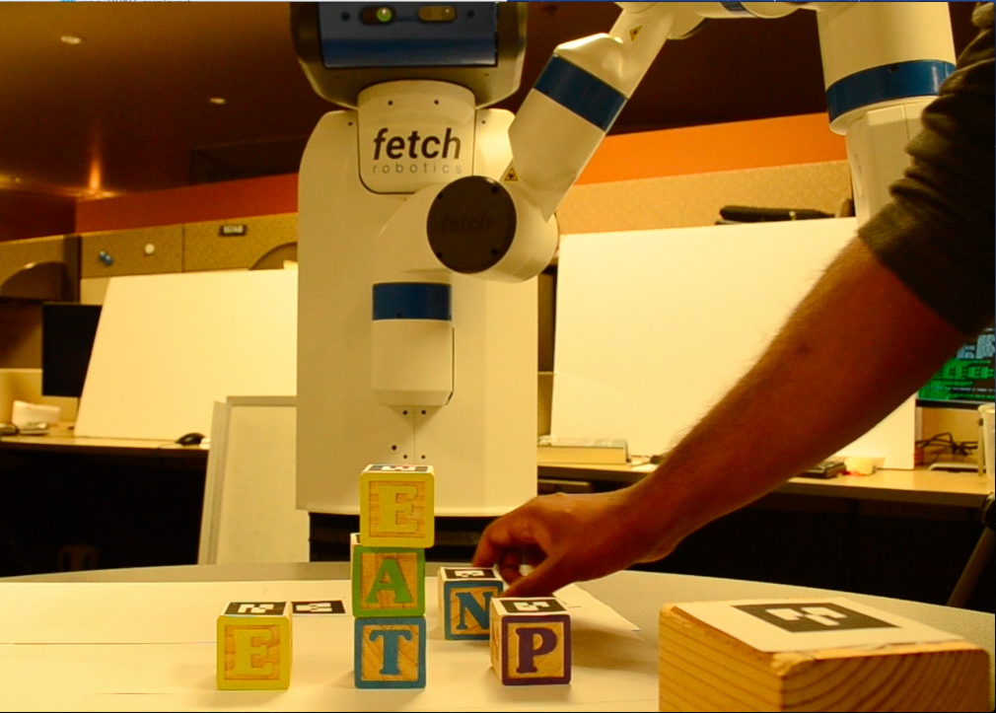
Outline
Human is a passive observer
Problem Formulation
Plan Generation
Experiment
Human is an active collaborator
Problem Formulation
Semantic Labeling
Experiment

Slide 11
Problem Formulation
Human’s expectation of agent’s model is in human’s mind and is unknown.
In order to generate explicable behavior, the challenge is to learn this inherently hidden model, M_{R}*.

Slide 12
Problem Formulation
Easier it is for humans to associate tasks/sub-goals to a plan, more is the plan explicable.
Plan = { a_{1,} a_{2,} a₃, …, a_{n} }
task₁
task₂
goal
M_{R}*
Human’s expectation of agent’s model is in human’s mind and is unknown.
In order to generate explicable behavior, the challenge is to learn this inherently hidden model, M_{R}*.
Psychological Studies: G. Csibra and G. Gergel 2007, R. Vallacher and D. Wegner, 1987

Slide 13
Problem Formulation
M_{R} (Actual robot model)

Slide 14
Problem Formulation
Plan = { a_{1,} a_{2,} a₃, …, a_{n} }
task₁
task₂
goal
M_{R}*
M_{R} (Actual robot model)

Slide 15
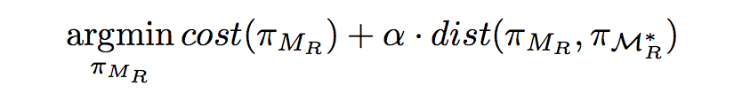
Problem Formulation
Given a goal, the objective is to find a robot plan that minimizes a weighted sum of cost of robot plan and differences between two plans (i.e. robot plan and human’s anticipation of the robot plan).
Plan = { a_{1,} a_{2,} a₃, …, a_{n} }
task₁
task₂
goal
M_{R}*
M_{R}

Slide 16
Problem Formulation
Given a goal, the objective is to find a robot plan:
Hidden model
Plan = { a_{1,} a_{2,} a₃, …, a_{n} }
task₁
task₂
goal
M_{R}*
M_{R}

Slide 17
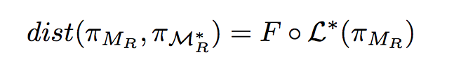
Problem Formulation
Given a goal, the objective is to find a robot plan:
Domain specific function
taking plan labels as input
Human’s labeling scheme
for robot plans based on M_{R}*
Plan = { a_{1,} a_{2,} a₃, …, a_{n} }
task₁
task₂
goal
M_{R}*
M_{R}

Slide 18
Problem Formulation
Given a goal, the objective is to find a robot plan:
Plan = { a_{1,} a_{2,} a₃, …, a_{n} }
Learned labeling scheme function using linear chain CRFs (Conditional Random Fields)
task₁
goal
task₂
M_{R}*
M_{R}

Slide 19
Plan Generation
M_{R}, initial (I) and goal (G) state
Stop
True
FastForward planner with enforced hill climbing search
Heuristic value computed using relaxed planning graph
If G is reached
False
s.plan = plan prefix from I
For each next state n from s, compute π_{RELAX} for n
Concatenate s.plan with
π_{RELAX} as π’
Trained human labeling
scheme L_{CRF}*
Compute L_{CRF}*(π’ ) and θ
Compute h = (θ, h_{cost})
Find state n* with min h

Slide 20
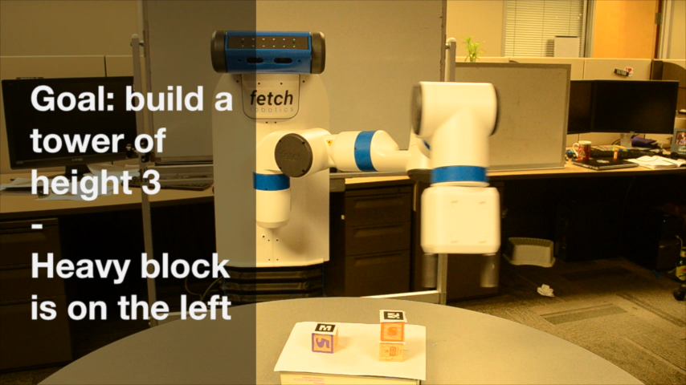
Experiment

Slide 21
Outline
Human is a passive observer
Problem Formulation
Plan Generation
Experiment
Human is an active collaborator
Problem Formulation
Semantic Labeling
Experiment

Slide 22
Problem Formulation
Plan = { a_{1,} a_{2,} a₃, …, a_{n} }
task₁
task₂
goal
M_{R}*
M_{R}

Slide 23
Problem Formulation
Apart from M_{R} , access to M_{H}* (approximate planning model of human) is provided
Plan = { a_{R1,} a_{H1,} a_{R2}, …, a_{Rn} }
task₁
task₂
goal
M_{R}*
M_{H} *
M_{R}

Slide 24
Problem Formulation
Apart from M_{R} , access to M_{H}* (approximate planning model of human) is provided
M_{H}* is different from M_{H} (actual human planning model)
Composite plan (π_{C}):
π_{C} captures actions performed by both human and robot to achieve their goals
Plan = { a_{R1,} a_{H1,} a_{R2}, …, a_{Rn} }
task₁
task₂
goal
M_{H}
M_{R}*
M_{H} *
M_{R}

Slide 25
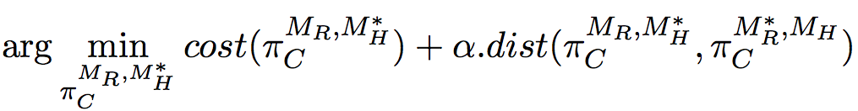
Problem Formulation
Plan = { a_{R1,} a_{H1,} a_{R2}, …, a_{Rn} }
Given the goals, objective is to find a robot plan:
task₁
task₂
goal
M_{H}
M_{R}*
M_{R}
M_{H}*
CRF trained on team
execution traces π_{C}

Slide 26
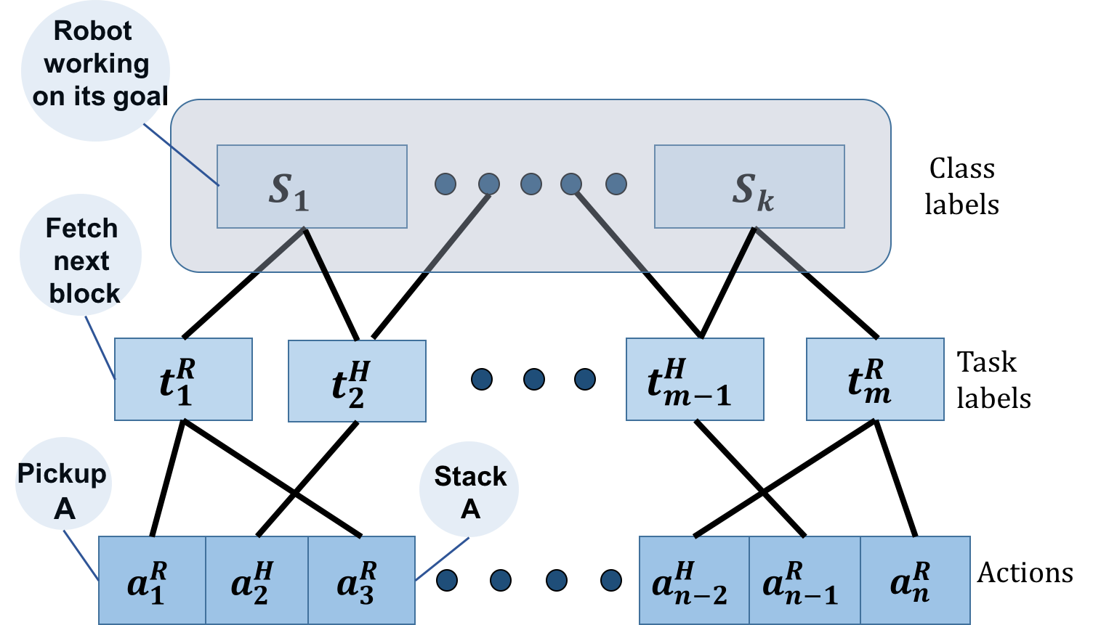
Semantic Labels
Semantic class labels
Robot working its own goal
Robot helping the human
Robot being disruptive to the human’s goal
Human performing his/her goal
Human helping the robot goal
Human performing non-optimal actions
Semantic Class Labels

Slide 27
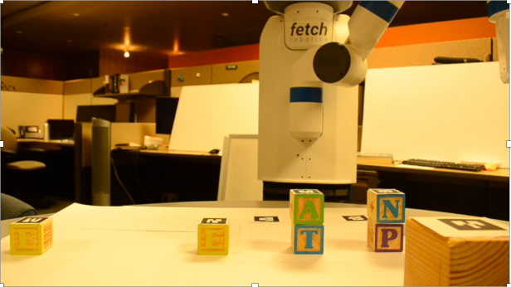
Experiment

Slide 28
Related Work
There exists work on generating legible robot motions¹
Two different task plans may map to exactly same motions
We are working with task planning
Model learning via learning from demonstration², inverse reinforcement learning³, cross-training⁴, and tutoring systems⁵
Previous approaches are about how one agent teaches the other agent in terms of its plan preference
Note that a preferred plan may not always be an expected plan
We are addressing the question of what humans would expect the robot to do rather than what humans themselves would do
1: A. Dragan and S. Srinivasa, 2013, 2: B.D. Argall et al., 2009, 3: P. Abbeel and A. Ng, 2004,
4: S. Nikolaidis et al. 2015, 5: T. Murray, 1999
Notes:
(mention point)
(mention example)

Slide 29
Conclusion
Introduced the explicability measure for task planning
Incorporated this measure as a heuristic in our search process
Investigated two general scenarios for planning with explicability
Human as a passive observer
Human-robot peer-to-peer teams
Evaluated task scenarios using physical robot experiments
Plan = { a_{1,} a_{2,} a₃, …, a_{n} }
task₁
task₂
goal
M_{R}*
M_{R}
Plan = { a_{R1,} a_{H1,} a_{R2}, …, a_{Rn} }
task₁
task₂
goal
M_{H}
M_{R}*
M_{R}
M_{H}*
Notes:
You need to distuiguish between the plans in the first and second scenarios

